Slide 1
Magento Training
Nov-14-2016
Chau Thanh Nhan

Slide 2
Summary
Project Name: Magento Training Pool
Customer:
Vaimo-Product Ower
Japan TCI- Project Management Group
Magento is an open source E-commerce software which is useful for online business and it has the flexible modular architecture. To ensure member have knowledge about Magento’s extension, we provide training for developer.

Slide 3
Project BACKGround
Scope of project
Technologies
Quality Control and Testing
Glossary
Possible Risk
Plan
Project Plan
Organizational chart
Master Schedule
Project’s role

Slide 4
Scope OF Project
Understand Magento 2 Framework
Understand of Magento 2 Development
Use OOP with Magento 2
Unit test

Slide 5





Technologies
Framework: Magento 2.1.1
Language: PHP5.6 and PHP7
Database: MySql 5.6
Web Server: Apache 2.2
Development Server: Ubuntu Linux
Development Perfomance: CPU i5 3.0GB, RAM 8GB

Slide 6
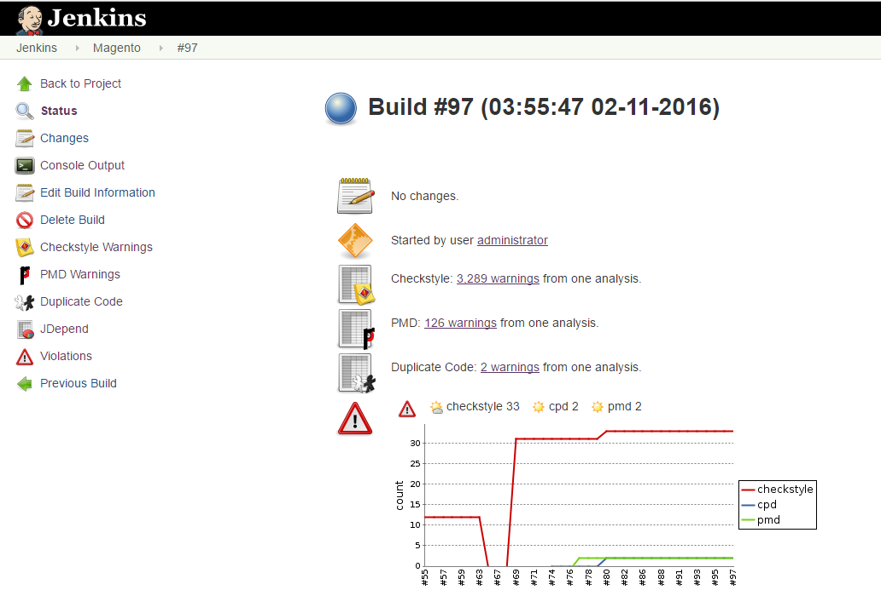

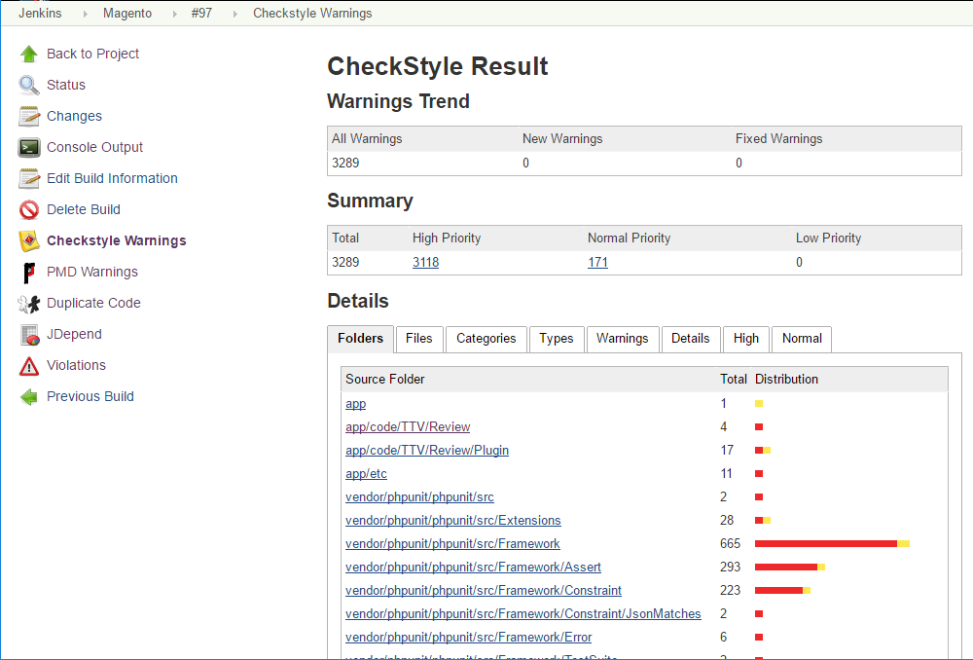
Quality control and testing
Static code analysis: Code style, performance, security,…

Slide 7
Quality control and testing (cont)
Phploc: can quickly measure the size of PHP project
Phpmd: scan PHP source code and looks for potential problems such as possible bugs, dead code,…
Phpcpd: is a copy/paste detector for php code. It scand PHP project for duplicated code.
Phpcs: detects violation of defined set of coding standards.
Reference:
AlecBedzir_Meet_Magento_Vietnam_October_2016_final.pdf

Slide 8
Possible Risk
Requirement is not clear because only reference from extension list.
Magento’s technical is new, many members have no experience.
Member have no experience about B2E business logic.

Slide 9
Project Plan
Phase 1: Training Technical training for developing Magento's extension. Preparing the consolidation of 5 month implementation phase of project Start up: Oct-2016
Estimated Effort: 5 Man-Month
Phase 2: On job Training Design and develop extension based on confirm from Japan TCI Start up: Mid Nov-2016
Estimated Effort: 2.5 Man-Month

Slide 10
organizational chart
Senior Manager
Nguyen Duc Tinh
Leader
Chau Thanh Nhan
Developer
Nguyen C. Binh
Developer
Le Hai Dang
Developer
Ngo Tran M. Duy
Developer
Vu Duc Thuan
Developer
Bui Viet Huong

Slide 11
Master Schedule
 | Oct | Nov | Dec | Jan | Feb | Mar
Training
On Job Training
11/10
12/7

Slide 12
Project’s Role
Role Name | Role
Senior Manager | Manage the project’s problem Control the project
Leader | Share project information Review and confirm the document Make the plan and monitor member Report the project progress
Developer | Get the requirement Implement the requirement Report to Leader

Slide 13
The end

